Slide 1
DeepSDF: Learning Continuous Signed Distance Functions for Shape Representation Jeong Joon Park, Peter Florence, Julian Straub, Richard Newcombe, Steven Lovegrove Facebook Reality Labs
Can Gümeli
WS2019
Advisor: Shun-Cheng Wu

Slide 2
Outline
Introduction
Related Work
Methodology
Experiments
Conclusion

Slide 3
Introduction

Slide 4
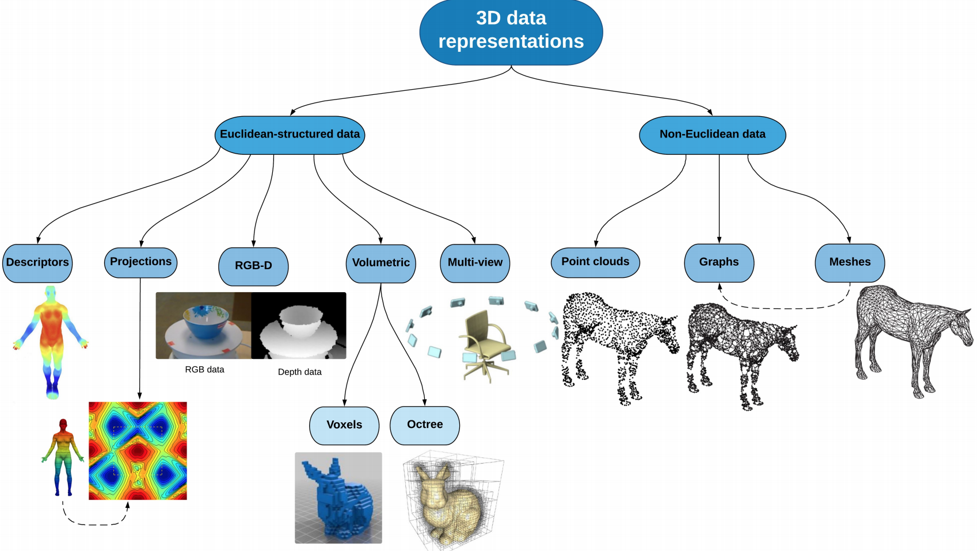
Problem: Representing 3D Shapes
How to represent 3D?
Many alternatives exist (Point Clouds, Meshes, Voxel Grids)
Efficient and accurate representations are needed for
Rendering
Reconstruction
Recognition
And more…
Ahmed, Eman, et al. "A survey on Deep Learning Advances on Different 3D Data Representations." arXiv preprint arXiv:1808.01462 (2018).

Slide 5
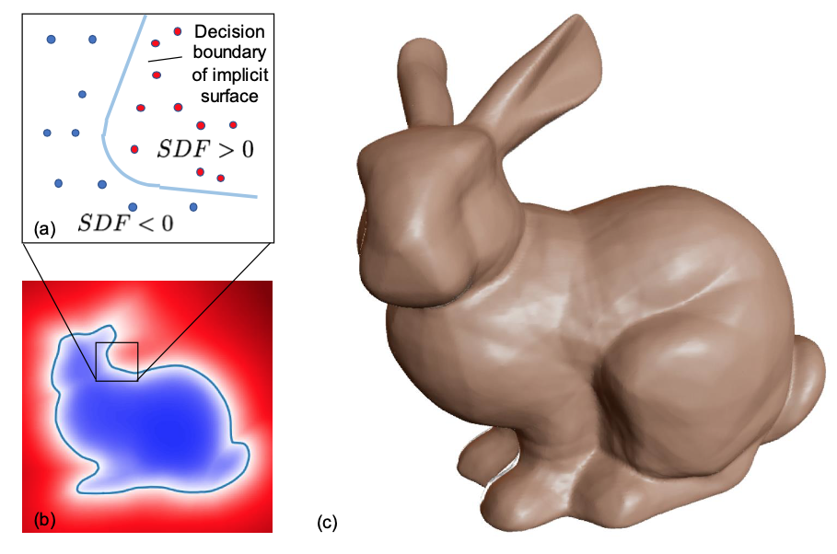
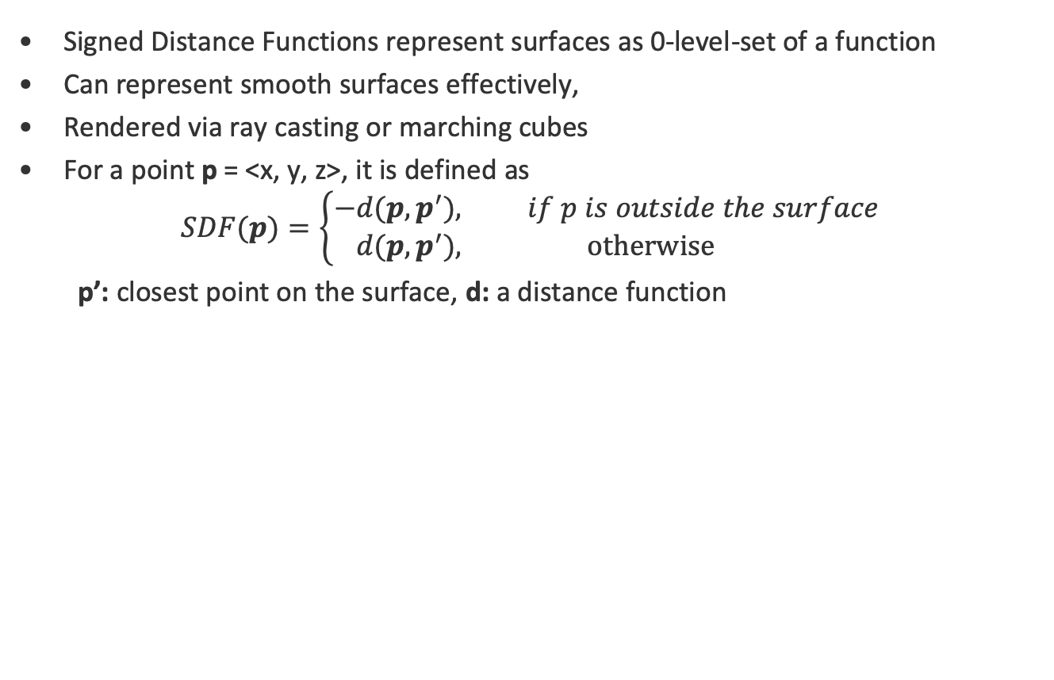
Signed Distance Functions
Signed Distance Functions represent surfaces as 0-level-set of a function
Can represent smooth surfaces effectively,
Rendered via ray casting or marching cubes
For a point p = <x, y, z>, it is defined as
$$SDF(p)=\left\{\begin{aligned}−&d(p, p^{′}), if p is outside the surface \\ &d(p, p^{′}), \text{otherwise}\end{aligned}\right.$$
p’: closest point on the surface, d: a distance function
Park, Jeong Joon, et al. "DeepSDF: Learning Continuous Signed Distance Functions for Shape Representation." Proceedings of the IEEE Conference on Computer Vision and Pattern Recognition. 2019.

Slide 6
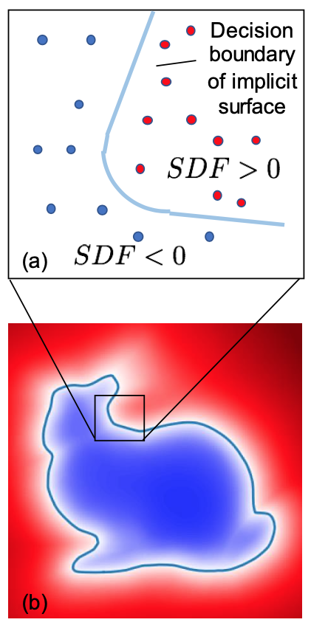
Motivation
Compact surface representations can be incomplete and low quality
SDFs are better, but commonly represented as inefficient voxel grids
Let’s learn continuous SDFs instead with a neural net!
It is like nonlinear binary classification
Park, Jeong Joon, et al. "DeepSDF: Learning Continuous Signed Distance Functions for Shape Representation." Proceedings of the IEEE Conference on Computer Vision and Pattern Recognition. 2019.

Slide 7
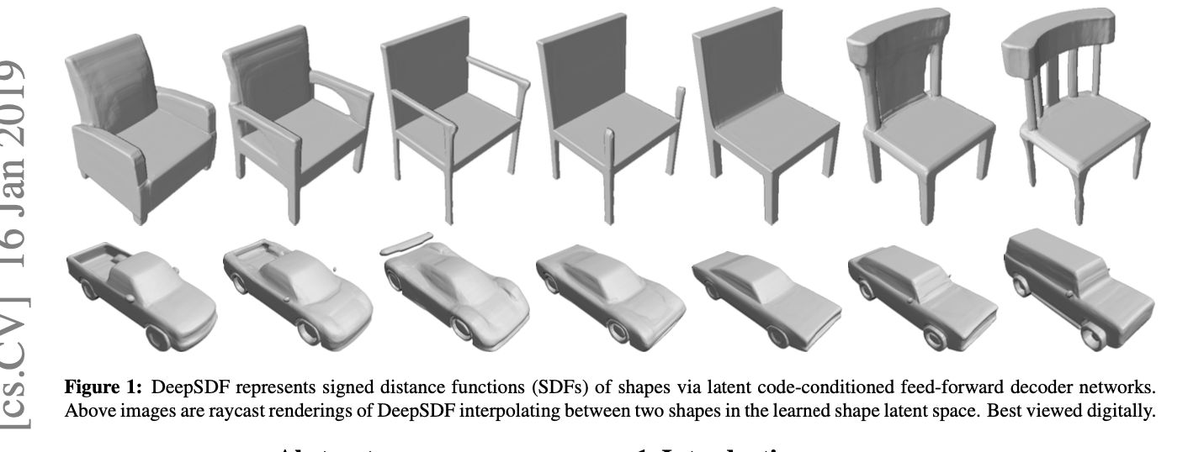
Contribution
Represent SDFs in continuous form using a generative model
Allow compression, interpolation and learning using learnable latent variable
p: <x, y, z>
Deep MLP
(Per Category)
SDFi(p)
Zi: Latent Vector
(Per Object, Learned)
Park, Jeong Joon, et al. "DeepSDF: Learning Continuous Signed Distance Functions for Shape Representation." Proceedings of the IEEE Conference on Computer Vision and Pattern Recognition. 2019.

Slide 8
Related Work

Slide 9
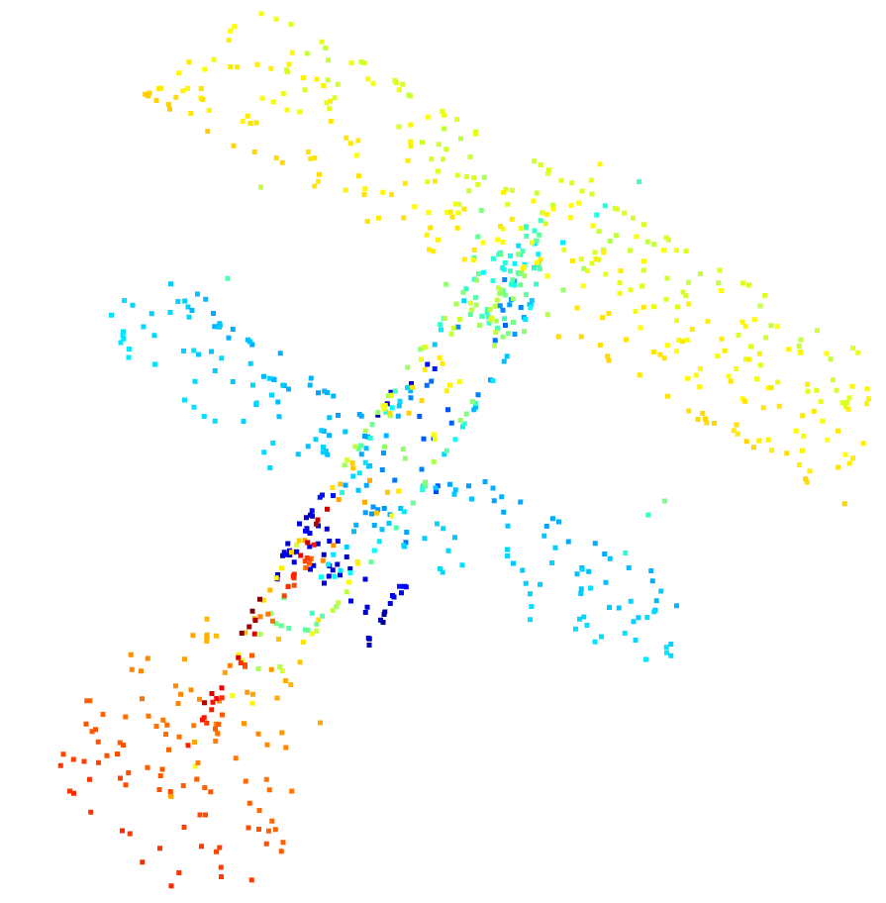
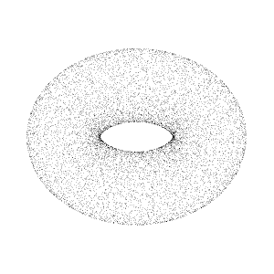
3D Shape Representation: Point-Based
Represents shape as a point set in the surface in compact form
Raw data format in sensors (i.e depth cameras, LiDARs)
Successful deep learning models exist. ☺
Lacks topology information, and not suitable for producing watertight (closed) surfaces ☹
https://en.wikipedia.org/wiki/Point_cloud#/media/File:Point_cloud_torus.gif
Wu, Zhirong, et al. "3d shapenets: A deep representation for volumetric shapes." Proceedings of the IEEE conference on computer vision and pattern recognition. 2015.

Slide 10
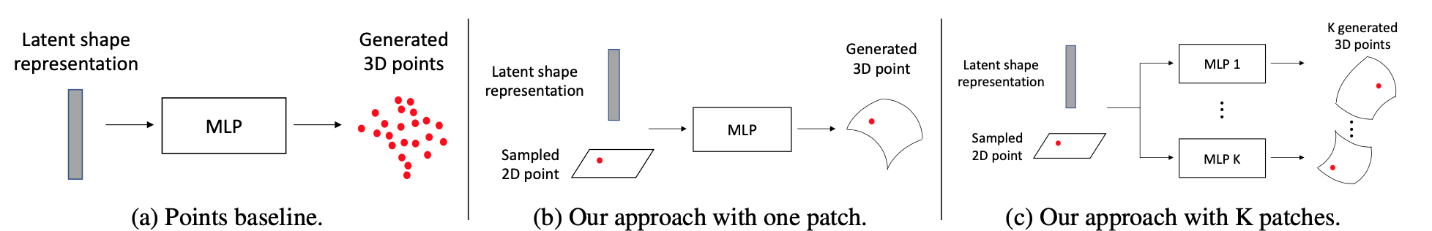
3D Shape Representation: Mesh-Based
Represent shapes as polygons over the surface
Default data format for rendering
Important related work for shape representation: AtlasNet
Parametrize meshes and use neural nets to encode☺
Cannot produce either watertight meshes or complex shapes ☹
Groueix, Thibault, et al. "AtlasNet: A Papier-M\^ ach\'e Approach to Learning 3D Surface Generation." arXiv preprint arXiv:1802.05384 (2018).

Slide 11
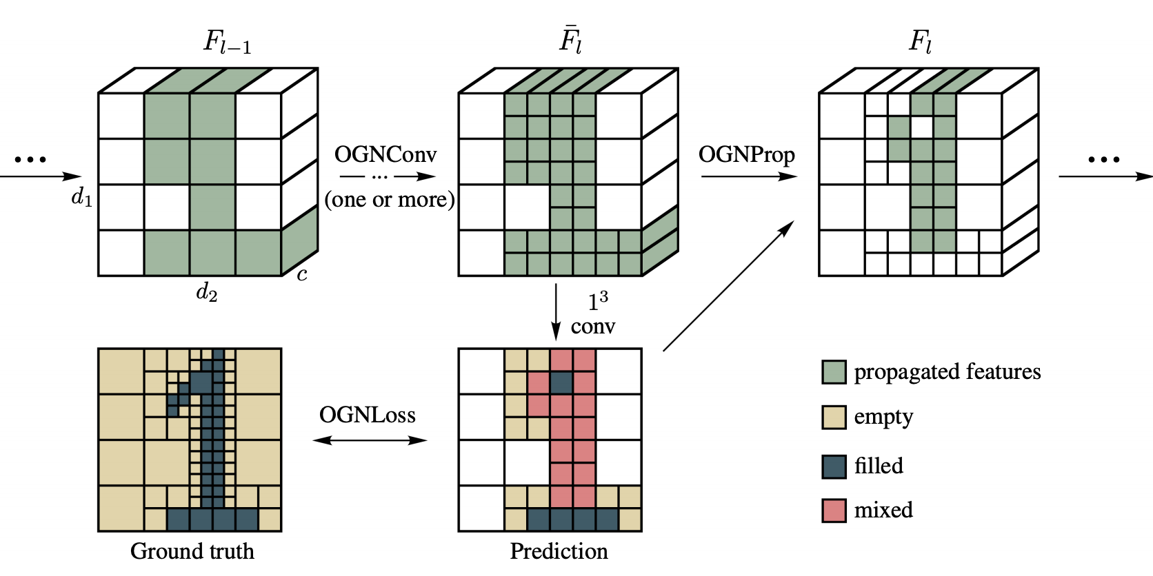
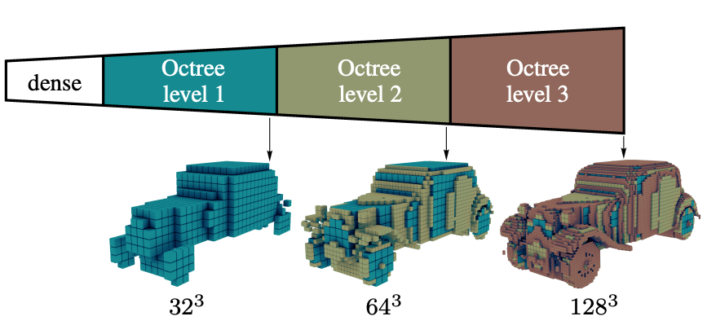
3D Shape Representation: Voxel-Based
Basically 3D images
Easy to do deep learning ☺
Represent discretized functions, one grid per shape (not shape category).
Important related work: OGN (Octree-based)
Tatarchenko, Maxim, Alexey Dosovitskiy, and Thomas Brox. "Octree generating networks: Efficient convolutional architectures for high-resolution 3d outputs." Proceedings of the IEEE International Conference on Computer Vision. 2017.

Slide 12
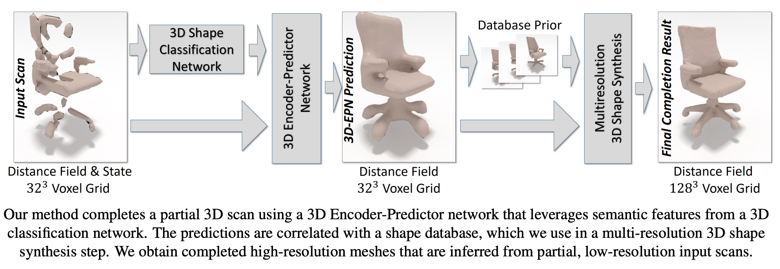
Shape Completion
3D-EPN (Discrete SDF) is the baseline model
Dai, Angela, Charles Ruizhongtai Qi, and Matthias Nießner. "Shape completion using 3d-encoder-predictor cnns and shape synthesis." Proceedings of the IEEE Conference on Computer Vision and Pattern Recognition. 2017.

Slide 13
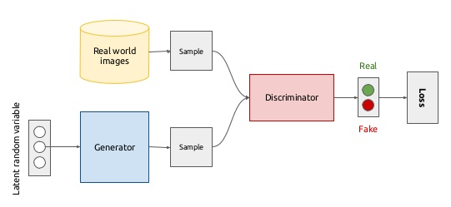
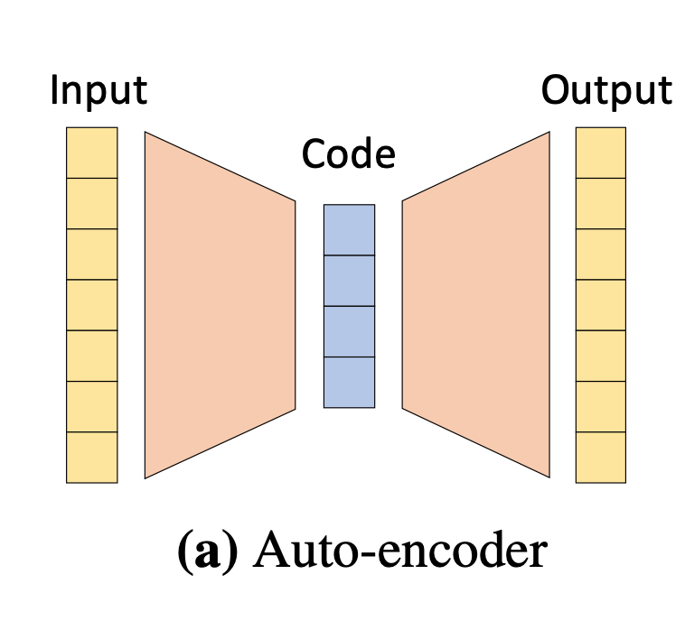
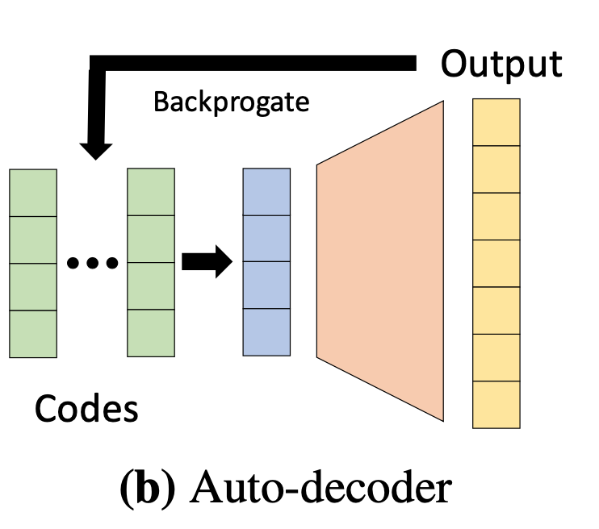
Generative Models
Learn to generate data from a latent vector:
GANs: Strong, but hard to optimize
Auto-Encoders: Why to encode latent code, if we won’t use the encoder?
Auto-Decoders: Simply learn latent code as an embedding
Generative Adversarial Network
https://dvl.in.tum.de/img/lectures/adl4cv.png
Park, Jeong Joon, et al. "DeepSDF: Learning Continuous Signed Distance Functions for Shape Representation." Proceedings of the IEEE Conference on Computer Vision and Pattern Recognition. 2019.

Slide 14
Methodology

Slide 15
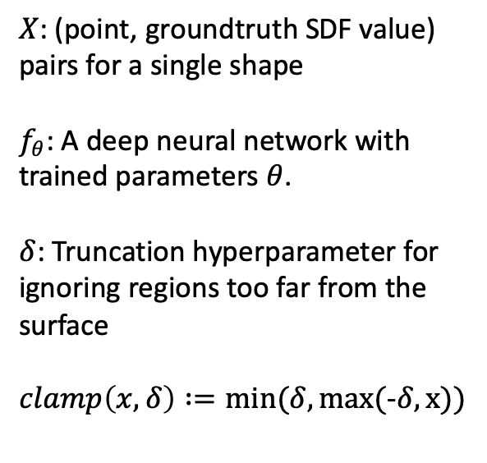
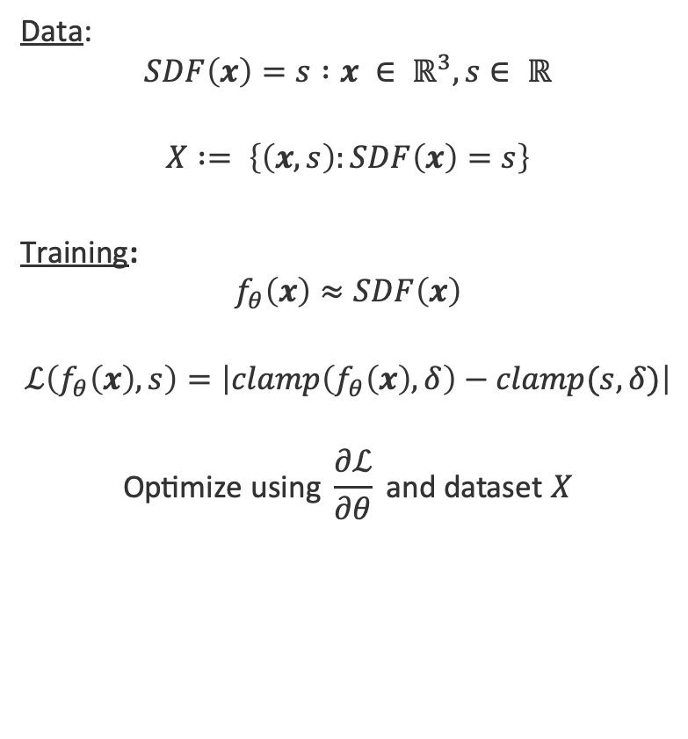
SDFs as Neural Networks
Data:
$$SDF\left(x\right)=s :x ∈ ℝ^{3}, s∈ ℝ$$
$$X := \left\{\left(x, s\right):SDF\left(x\right)=s\right\}$$
Training:
$$f_{θ}\left(x\right)≈SDF\left(x\right)$$
$$ℒ\left(f_{θ}\left(x\right), s\right)=\left|clamp\left(f_{θ}\left(x\right), δ\right)−clamp(s,δ)\right|$$
$$\text{Optimize} \text{using} \frac{∂ℒ}{∂θ} \text{and} \text{dataset} X$$
$X$: (point, groundtruth SDF value) pairs for a single shape
$f_{θ}$: A deep neural network with trained parameters $θ$.
$δ$: Truncation hyperparameter for ignoring regions too far from the surface
$clamp\left(x,δ\right) :=min(δ, max($-$δ, x))$
Park, Jeong Joon, et al. "DeepSDF: Learning Continuous Signed Distance Functions for Shape Representation." Proceedings of the IEEE Conference on Computer Vision and Pattern Recognition. 2019.

Slide 16
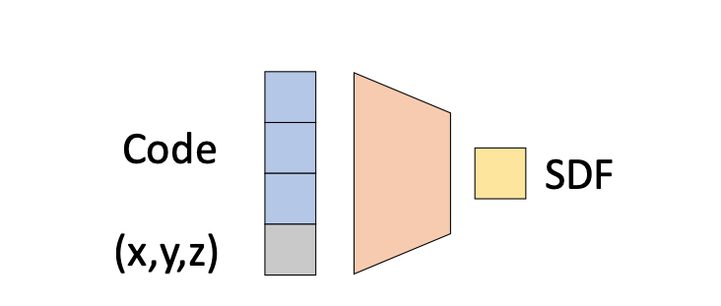
Deep SDF as a Conditional Auto-Decoder
Latent vector: Learned embedding for each shape
Condition: 3D coordinates
Output: Signed distance value
Park, Jeong Joon, et al. "DeepSDF: Learning Continuous Signed Distance Functions for Shape Representation." Proceedings of the IEEE Conference on Computer Vision and Pattern Recognition. 2019.

Slide 17
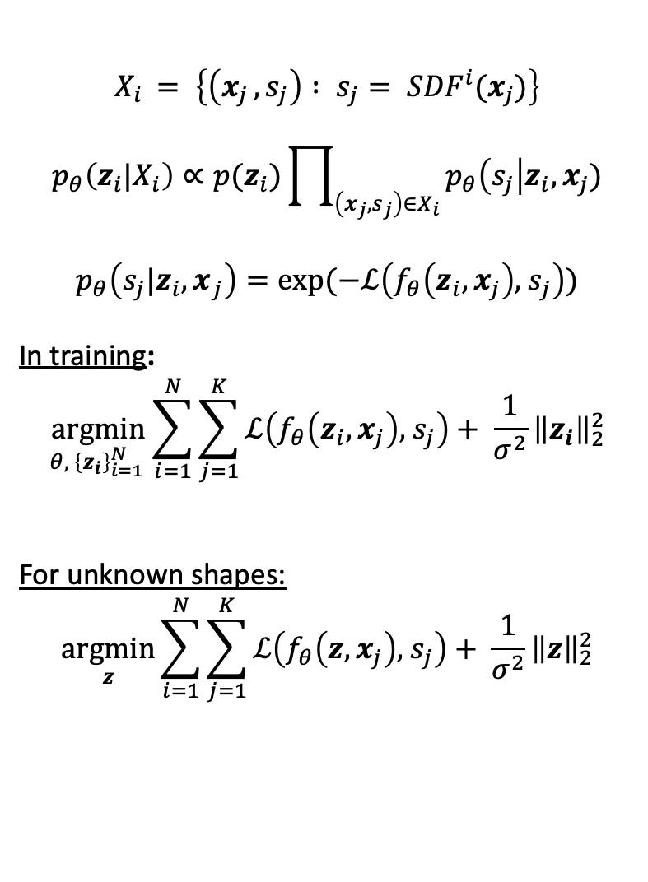
Auto-Decoder Based Formulation
$$X_{i }= \left\{\left(x_{j }, s_{j}\right) : s_{j}= {SDF}^{i}(x_{j})\right\}$$
$$p_{θ}\left(z_{i}{|X}_{i}\right)∝p(z_{i})\prod_{\left(x_{j}, s_{j}\right)∈X_{i}}{p_{θ}\left(s_{j}\right|z_{i}, x_{j})}$$
$$p_{θ}\left(s_{j}{|z_{i},x}_{j}\right)=exp(−ℒ\left(f_{θ}\left(z_{i}, x_{j}\right),{ s}_{j}\right))$$
In training:
$$\underset{{θ, \left\{z_{i}\right\}}_{i=1 }^{N}}{argmin}{\sum_{i=1}^{N}{\sum_{j=1}^{K}{ℒ\left(f_{θ}\left(z_{i}, x_{j}\right),{ s}_{j}\right)+ \frac{1}{σ^{2}}}}}{\left\|z_{i}\right\|}_{2}^{2}$$
For unknown shapes:
$$\underset{z}{argmin}{\sum_{i=1}^{N}{\sum_{j=1}^{K}{ℒ\left(f_{θ}\left(z, x_{j}\right),{ s}_{j}\right)+ \frac{1}{σ^{2}}}}}{\left\|z\right\|}_{2}^{2}$$
i: Index of a shape in the dataset
j: Index of a point in a shape
Park, Jeong Joon, et al. "DeepSDF: Learning Continuous Signed Distance Functions for Shape Representation." Proceedings of the IEEE Conference on Computer Vision and Pattern Recognition. 2019.

Slide 18
Dataset Preparation
ShapeNet is used
Coordinates were normalized to the unit sphere
500k spatial points were sampled
Points from the surface are densely sampled using multiple cameras
For each sampled point, closest point in the surface is computed
Non-watertight shapes are ignored (by checking visibility of different triangle surfaces)
Chang, Angel X., et al. "Shapenet: An information-rich 3d model repository." arXiv preprint arXiv:1512.03012 (2015).

Slide 19
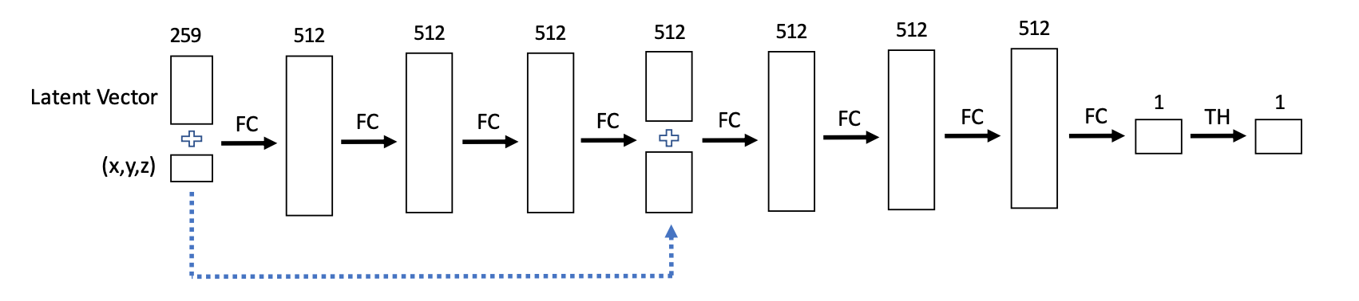
Architecture and Training Details
Adam optimizer is used
𝛿 is set to 0.1
Latent vectors are initialized from N(0, 0.001)
Weight normalization is used
Trained 8 Hours on 8 GPUs, for 1000 epochs
Park, Jeong Joon, et al. "DeepSDF: Learning Continuous Signed Distance Functions for Shape Representation." Proceedings of the IEEE Conference on Computer Vision and Pattern Recognition. 2019.
Salimans, Tim, and Durk P. Kingma. "Weight normalization: A simple reparameterization to accelerate training of deep neural networks." Advances in Neural Information Processing Systems. 2016.
Kingma, Diederik P., and Jimmy Ba. "Adam: A method for stochastic optimization." arXiv preprint arXiv:1412.6980 (2014).

Slide 20
Experiments

Slide 21
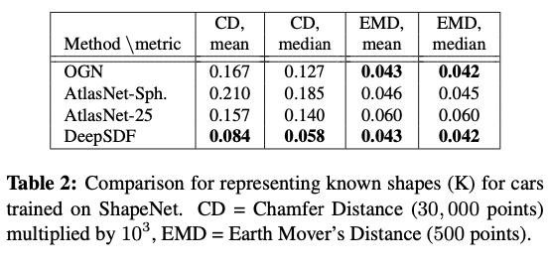
Representing Known Shape Databases
We try to overfit to training instances, one network per category
Data compression quality, not learning
OGN and AtlasNet benchmarks are trained per category
Park, Jeong Joon, et al. "DeepSDF: Learning Continuous Signed Distance Functions for Shape Representation." Proceedings of the IEEE Conference on Computer Vision and Pattern Recognition. 2019.
Tatarchenko, Maxim, Alexey Dosovitskiy, and Thomas Brox. "Octree generating networks: Efficient convolutional architectures for high-resolution 3d outputs." Proceedings of the IEEE International Conference on Computer Vision. 2017.

Slide 22
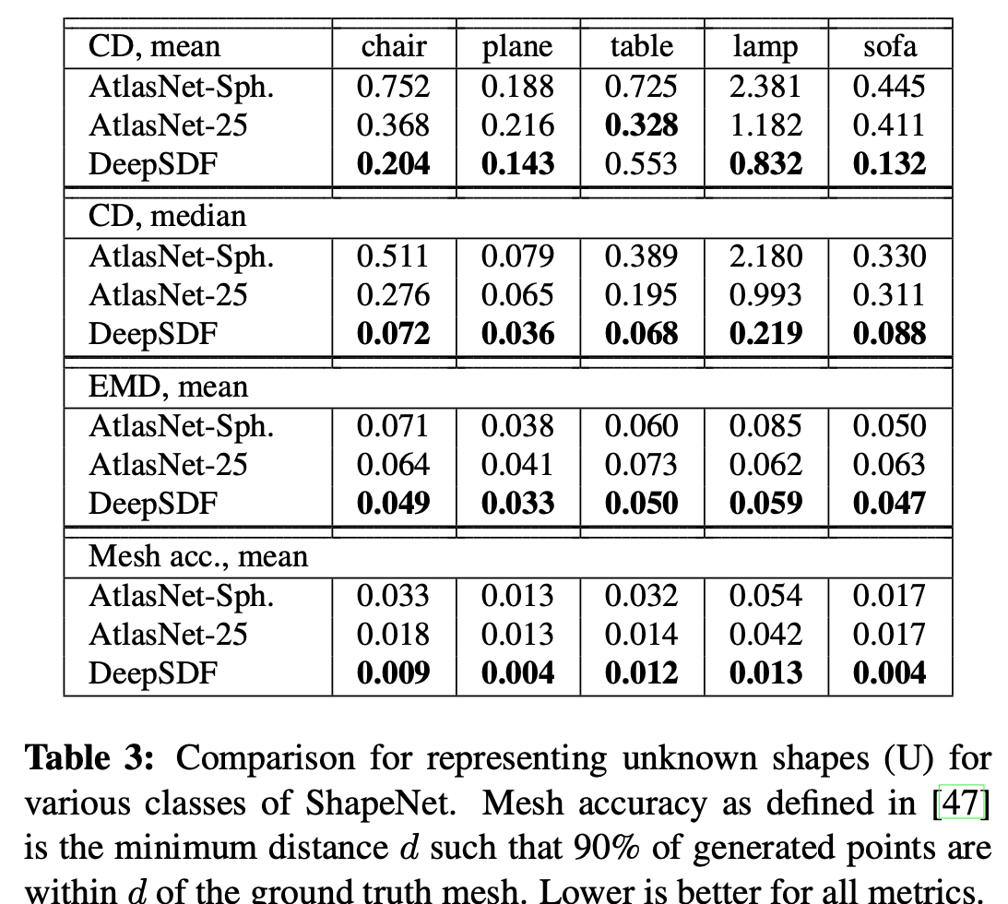
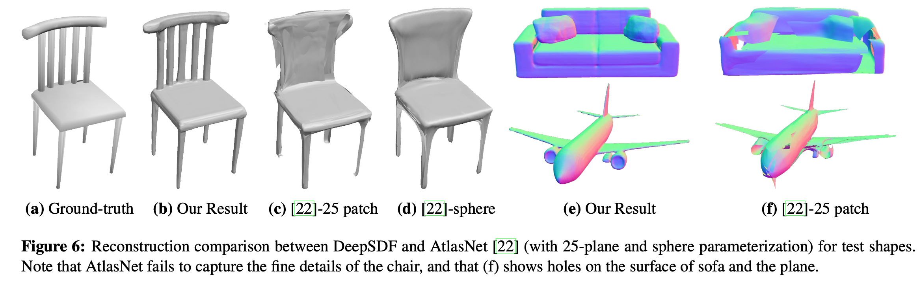
Generalizing to Test Shapes
Optimize latent space for different shapes from a category
Park, Jeong Joon, et al. "DeepSDF: Learning Continuous Signed Distance Functions for Shape Representation." Proceedings of the IEEE Conference on Computer Vision and Pattern Recognition. 2019.
Groueix, Thibault, et al. "AtlasNet: A Papier-M\^ ach\'e Approach to Learning 3D Surface Generation." arXiv preprint arXiv:1802.05384 (2018).

Slide 23
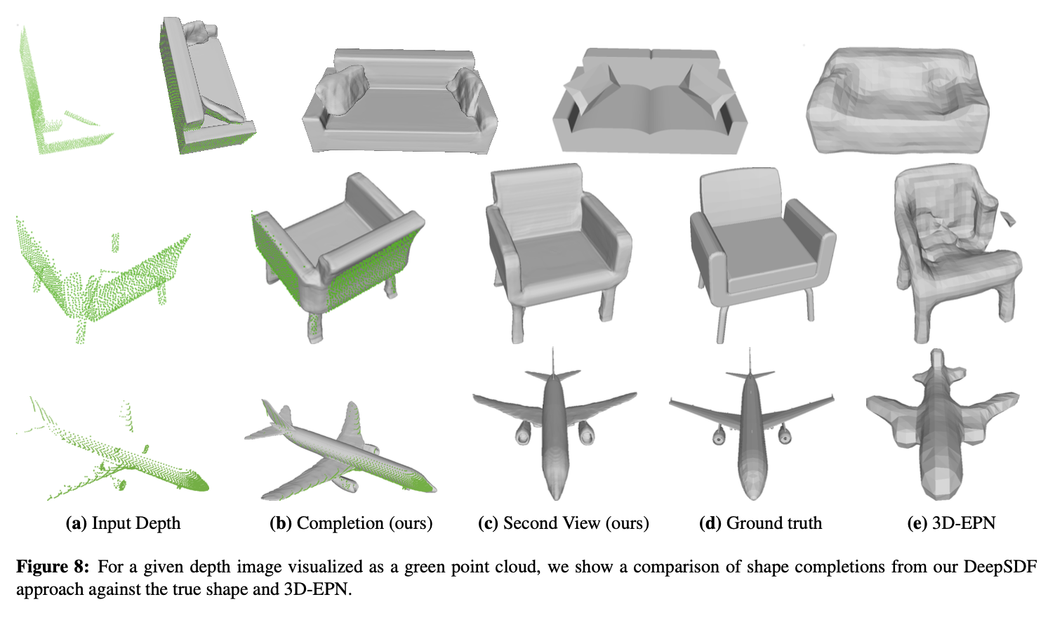
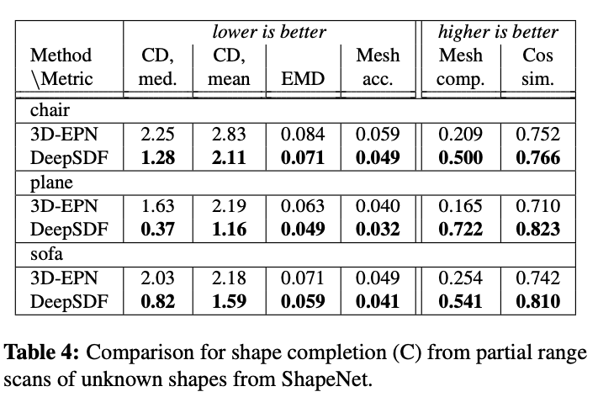
Shape Completion
Use depth images from one view.
Use a trained network for category, optimize the latent vector, forward pass
Park, Jeong Joon, et al. "DeepSDF: Learning Continuous Signed Distance Functions for Shape Representation." Proceedings of the IEEE Conference on Computer Vision and Pattern Recognition. 2019.
Dai, Angela, Charles Ruizhongtai Qi, and Matthias Nießner. "Shape completion using 3d-encoder-predictor cnns and shape synthesis." Proceedings of the IEEE Conference on Computer Vision and Pattern Recognition. 2017.

Slide 24
Latent Space Interpolation
Qualitative results are used to show embedding quality
Park, Jeong Joon, et al. "DeepSDF: Learning Continuous Signed Distance Functions for Shape Representation." Proceedings of the IEEE Conference on Computer Vision and Pattern Recognition. 2019.

Slide 25
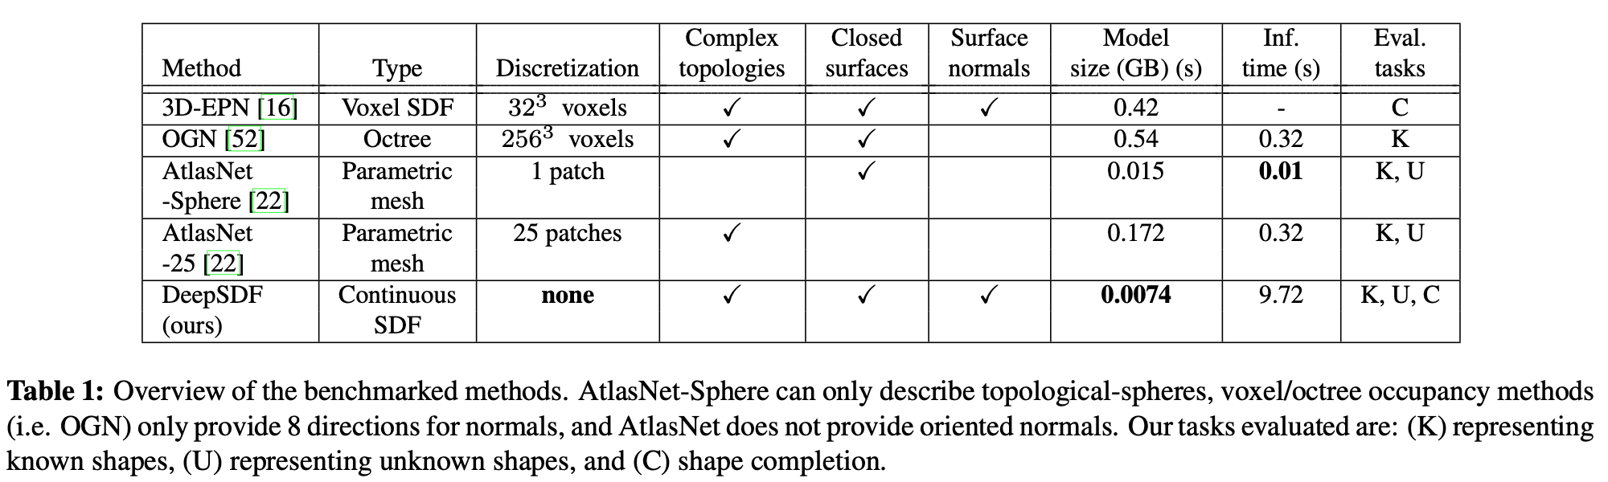
Computational Efficiency
Park, Jeong Joon, et al. "DeepSDF: Learning Continuous Signed Distance Functions for Shape Representation." Proceedings of the IEEE Conference on Computer Vision and Pattern Recognition. 2019.
Tatarchenko, Maxim, Alexey Dosovitskiy, and Thomas Brox. "Octree generating networks: Efficient convolutional architectures for high-resolution 3d outputs." Proceedings of the IEEE International Conference on Computer Vision. 2017.
Groueix, Thibault, et al. "AtlasNet: A Papier-M\^ ach\'e Approach to Learning 3D Surface Generation." arXiv preprint arXiv:1802.05384 (2018).
Dai, Angela, Charles Ruizhongtai Qi, and Matthias Nießner. "Shape completion using 3d-encoder-predictor cnns and shape synthesis." Proceedings of the IEEE Conference on Computer Vision and Pattern Recognition. 2017.

Slide 26
Conclusion

Slide 27
Authors’ Conclusions
Complex shapes can be represented efficiently and accurately ☺
Latent space optimization in inference should be improved ☹
Representation without discretization errors is good ☺
Assumed canonical pose, should be improved for the wild ☹
My Additions
Different applications of this model can be explored ☺
Unclear how to input this representation to neural nets without discretization ☹

Slide 28
Backup Slides

Slide 29
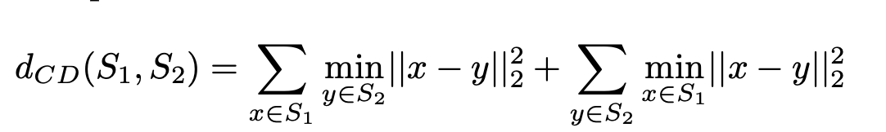
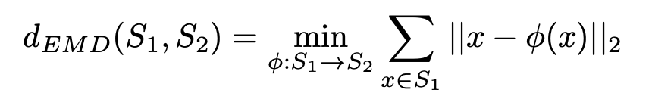
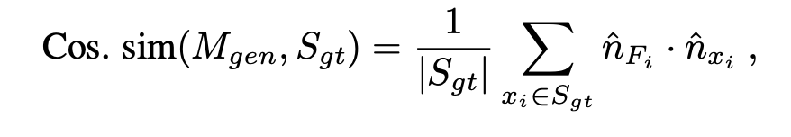
Measurement Methods
Chamfer Distance:
Earth Mover’s (Wasserstein) Distance:
Mesh Accuracy: Minimum distance from mesh contains 90% of GT points
Mesh Completion: Fraction of points within distance 0.01 from the groundtruth
Mesh Cosine Similarity: For a generated mesh and ground-truth points
Park, Jeong Joon, et al. "DeepSDF: Learning Continuous Signed Distance Functions for Shape Representation." Proceedings of the IEEE Conference on Computer Vision and Pattern Recognition. 2019.

Slide 30
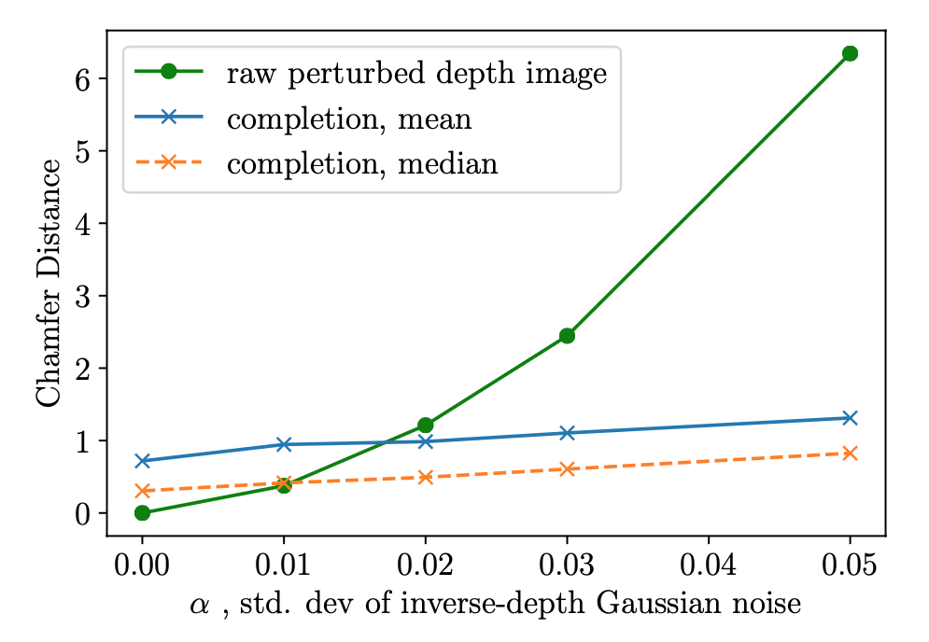
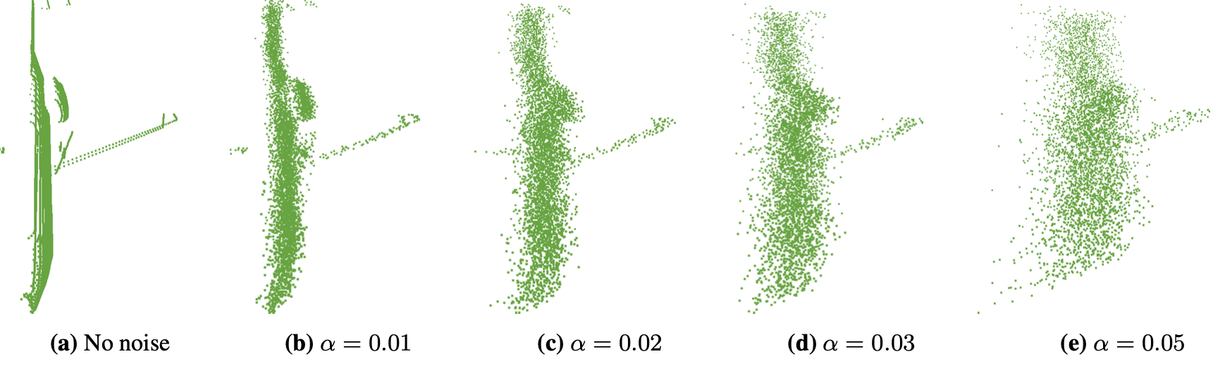
Effect of Noise
They injected gaussian noise to depth images in shape completion
Park, Jeong Joon, et al. "DeepSDF: Learning Continuous Signed Distance Functions for Shape Representation." Proceedings of the IEEE Conference on Computer Vision and Pattern Recognition. 2019.

Slide 31
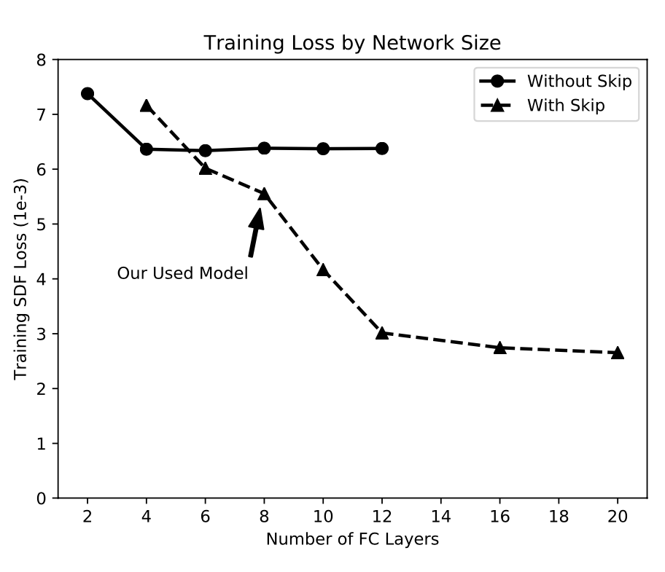
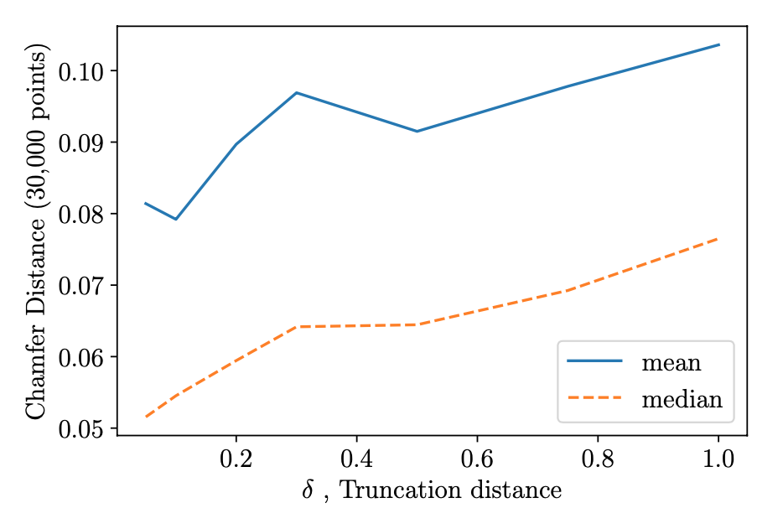
Ablation Studies
Skip connections allow larger models to train
Larger truncation distances reduce performance.
Park, Jeong Joon, et al. "DeepSDF: Learning Continuous Signed Distance Functions for Shape Representation." Proceedings of the IEEE Conference on Computer Vision and Pattern Recognition. 2019.

Slide 32
Evaluation of Baseline Models
Compared methods are trained on single-class
Using same train/val splits

Slide 33
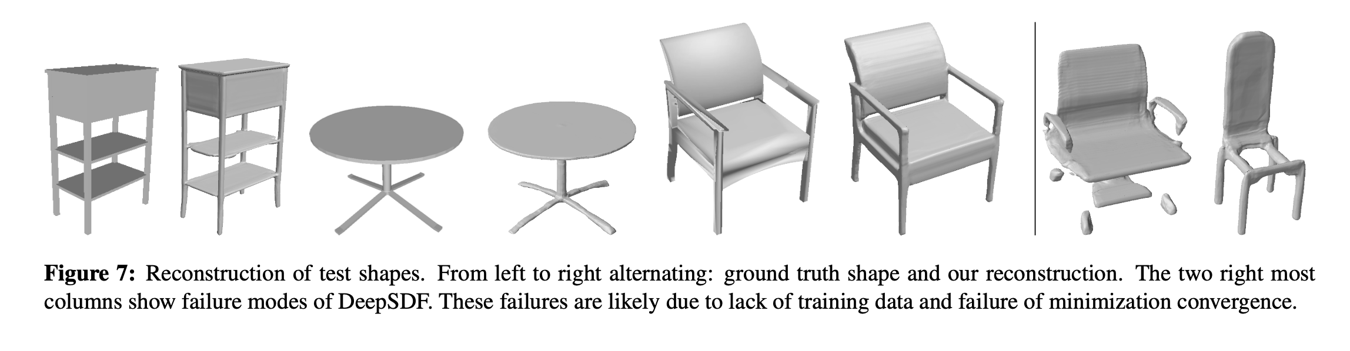
Failure Cases
Park, Jeong Joon, et al. "DeepSDF: Learning Continuous Signed Distance Functions for Shape Representation." Proceedings of the IEEE Conference on Computer Vision and Pattern Recognition. 2019.

